Slide 1


WELCOME
IN498 – Capstone in Analytics
UPDATED: JUNE 20, 2018

Slide 2

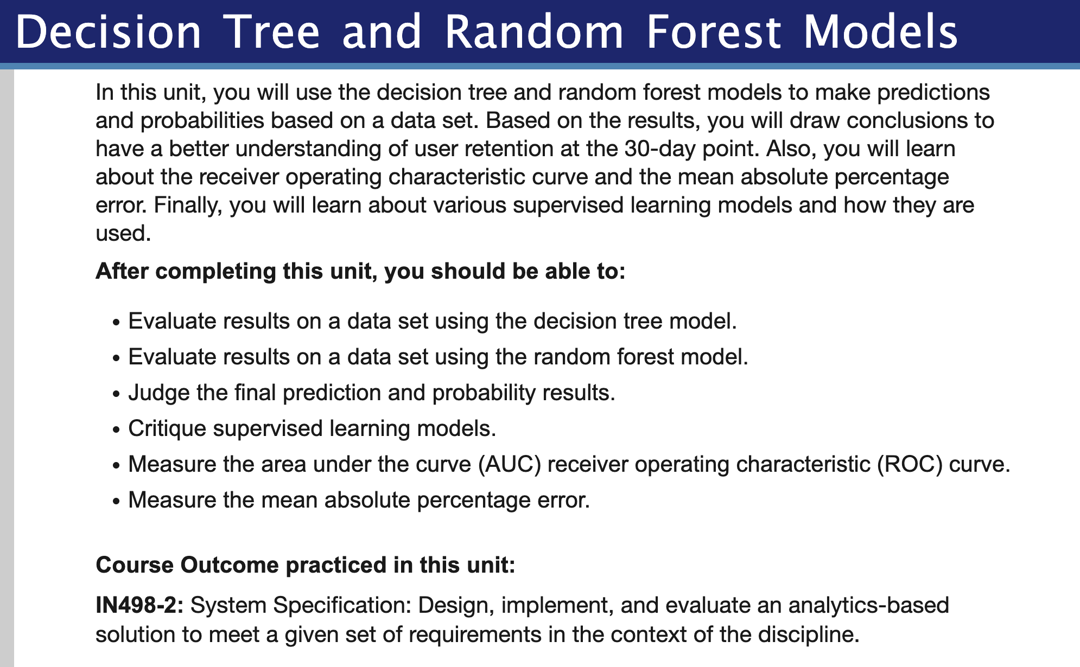
Overview
Purdue University Global |Foundations of Purdue Global Culture

Slide 3
Unit 4
Be sure to review Unit 4 in Brightspace for more details
Reading
-- See next slide
Discussion Question (20 points)
-- See following slides.
Assignment (60 points)
-- See following slides.
Seminar (20 points)
-- Option 1: Attend each week.
-- Option 2: Reflective Assignment.
Purdue University Global |Foundations of Purdue Global Culture

Slide 4
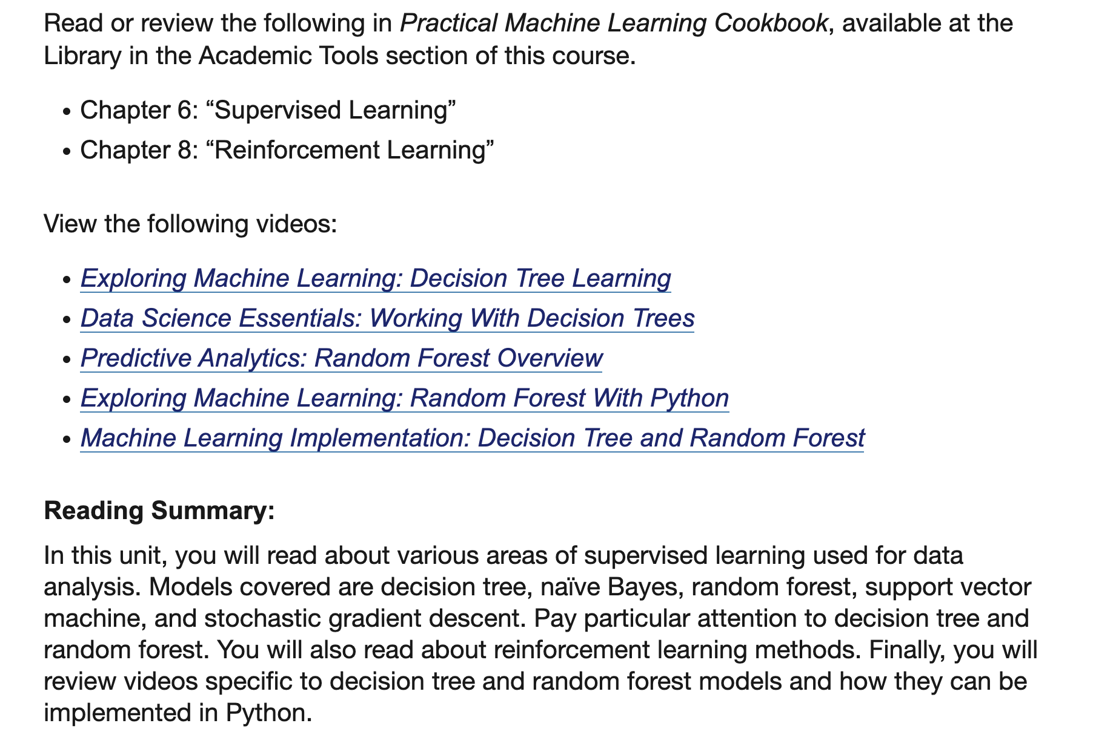
Reading
Purdue University Global |Foundations of Purdue Global Culture

Slide 5
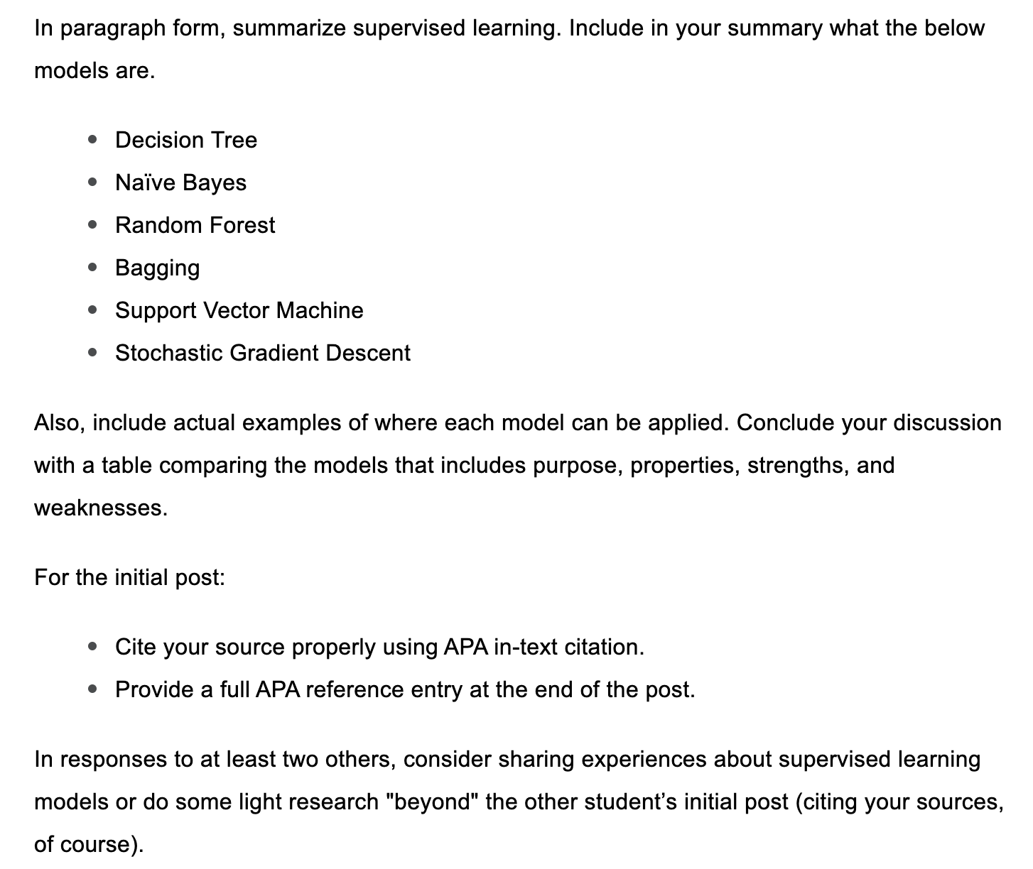
Discussion
Purdue University Global |Foundations of Purdue Global Culture

Slide 6
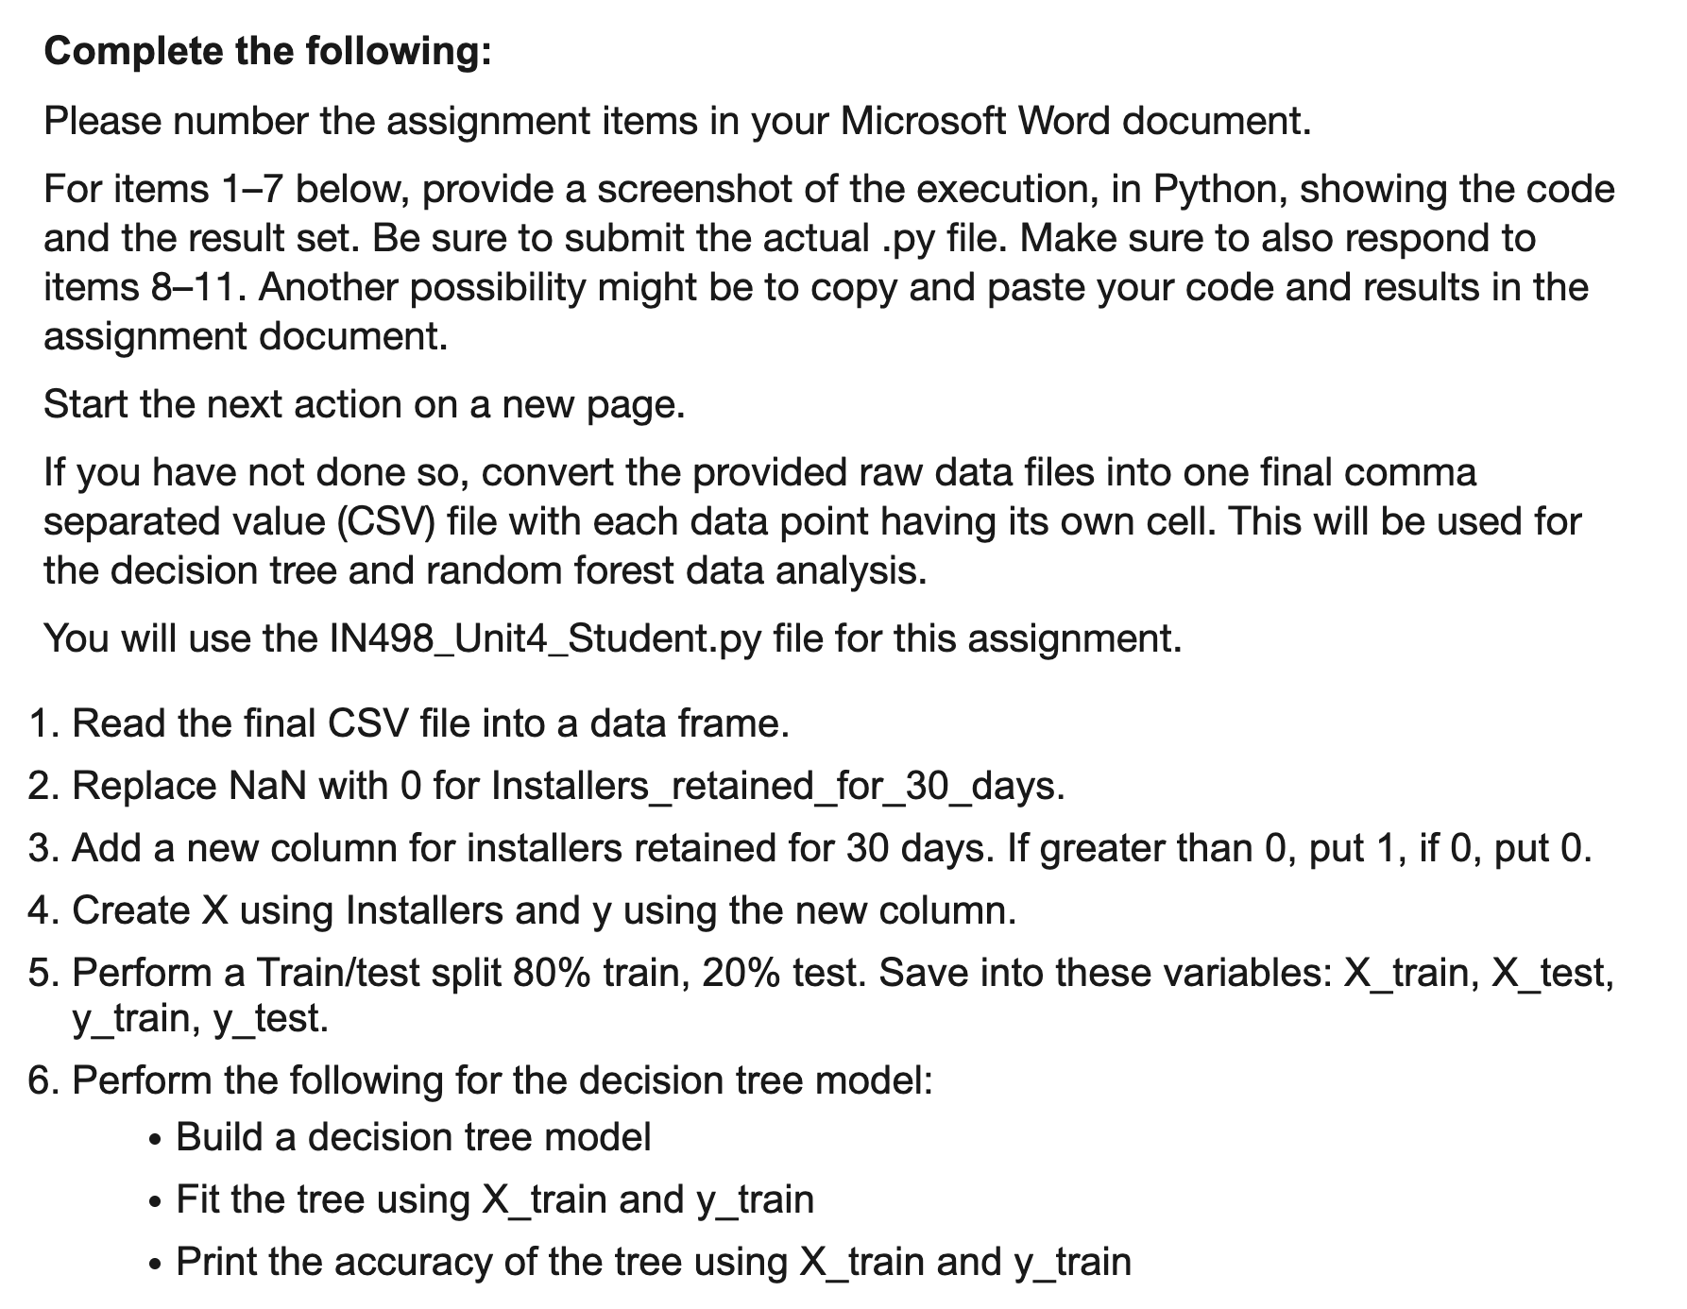
Assignment
Purdue University Global |Foundations of Purdue Global Culture

Slide 7
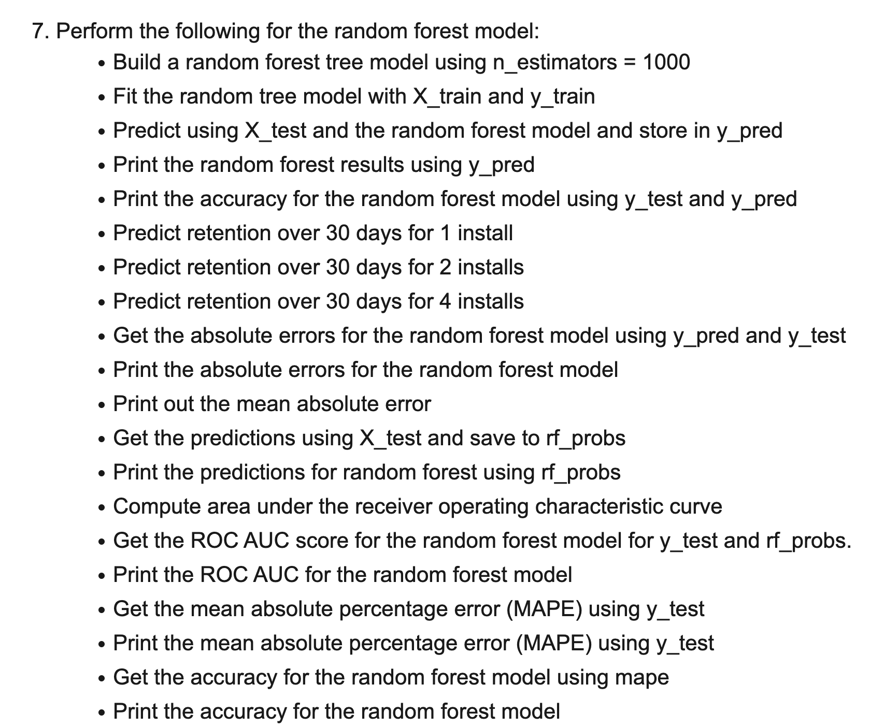
Assignment
Purdue University Global |Foundations of Purdue Global Culture

Slide 8
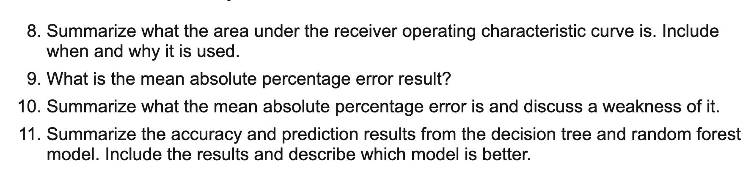
Assignment
Purdue University Global |Foundations of Purdue Global Culture

Slide 9
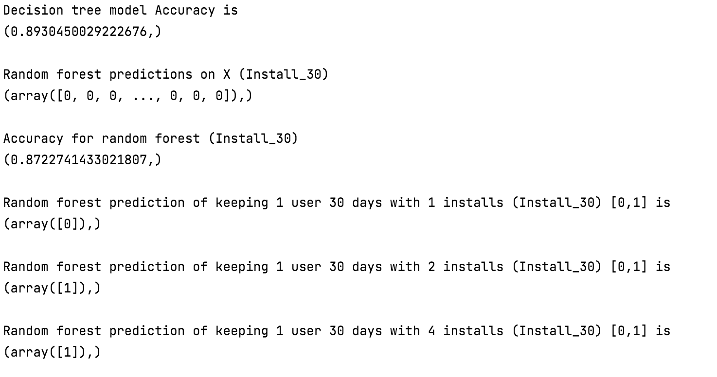
Assignment
Purdue University Global |Foundations of Purdue Global Culture

Slide 10
Assignment Rubric
See document in Course Resources-> Grading Rubrics.
Purdue University Global |Foundations of Purdue Global Culture

Slide 11
Unit 4

Slide 12
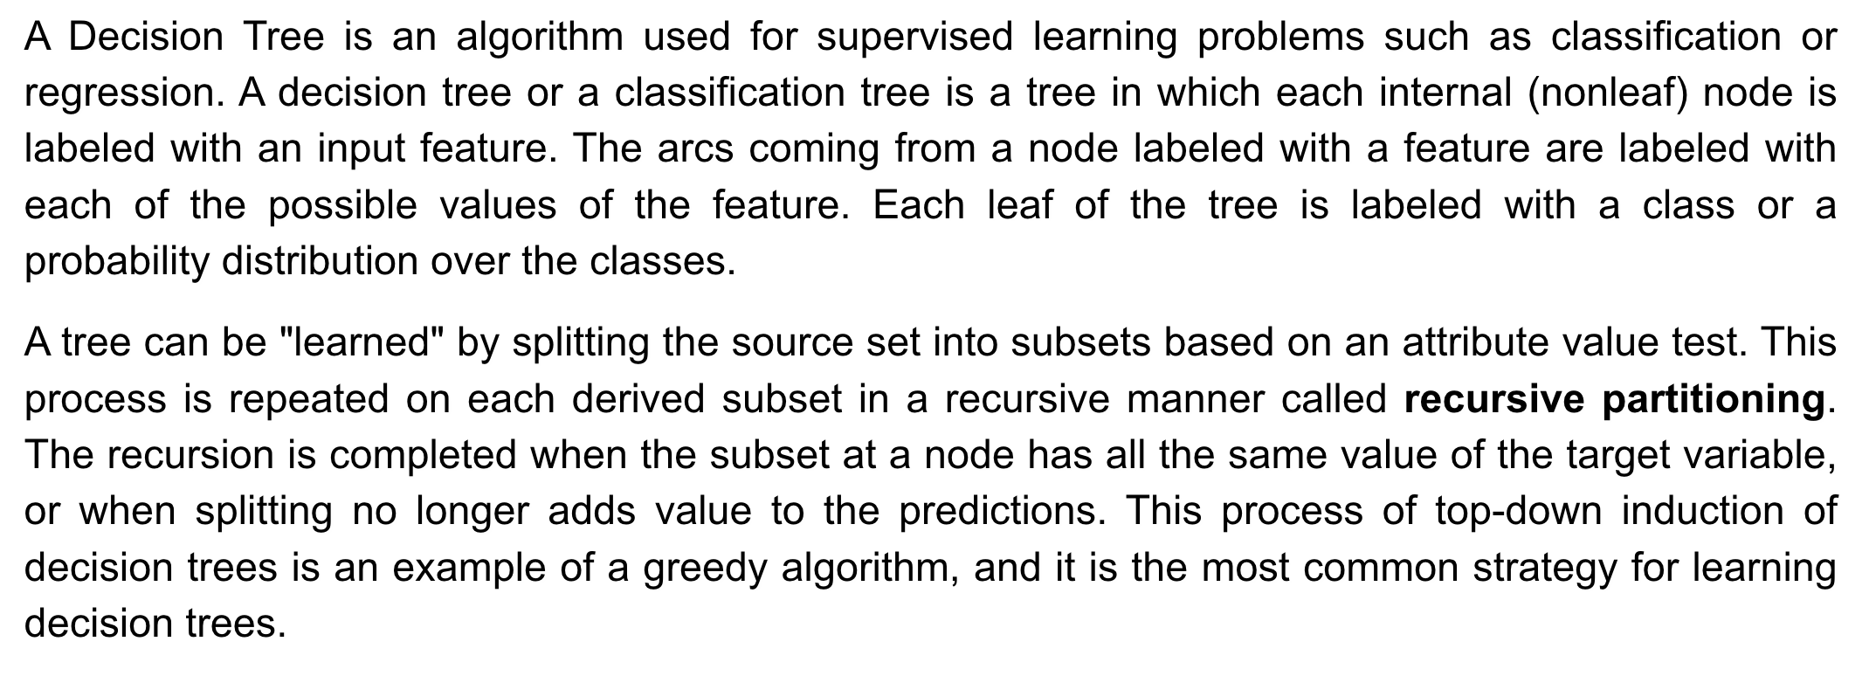
Decision Tree
Purdue University Global |Foundations of Purdue Global Culture
Notes:
https://www.tutorialspoint.com/big_data_analytics/decision_trees.htm#:~:text=A%20Decision%20Tree%20is%20an,such%20as%20classification%20or%20regression.&text=Each%20leaf%20of%20the%20tree,on%20an%20attribute%20value%20test.

Slide 13
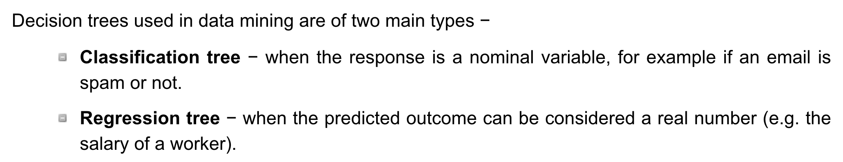
Decision Tree Use Cases
Purdue University Global |Foundations of Purdue Global Culture
Notes:
https://www.tutorialspoint.com/big_data_analytics/decision_trees.htm#:~:text=A%20Decision%20Tree%20is%20an,such%20as%20classification%20or%20regression.&text=Each%20leaf%20of%20the%20tree,on%20an%20attribute%20value%20test.

Slide 14
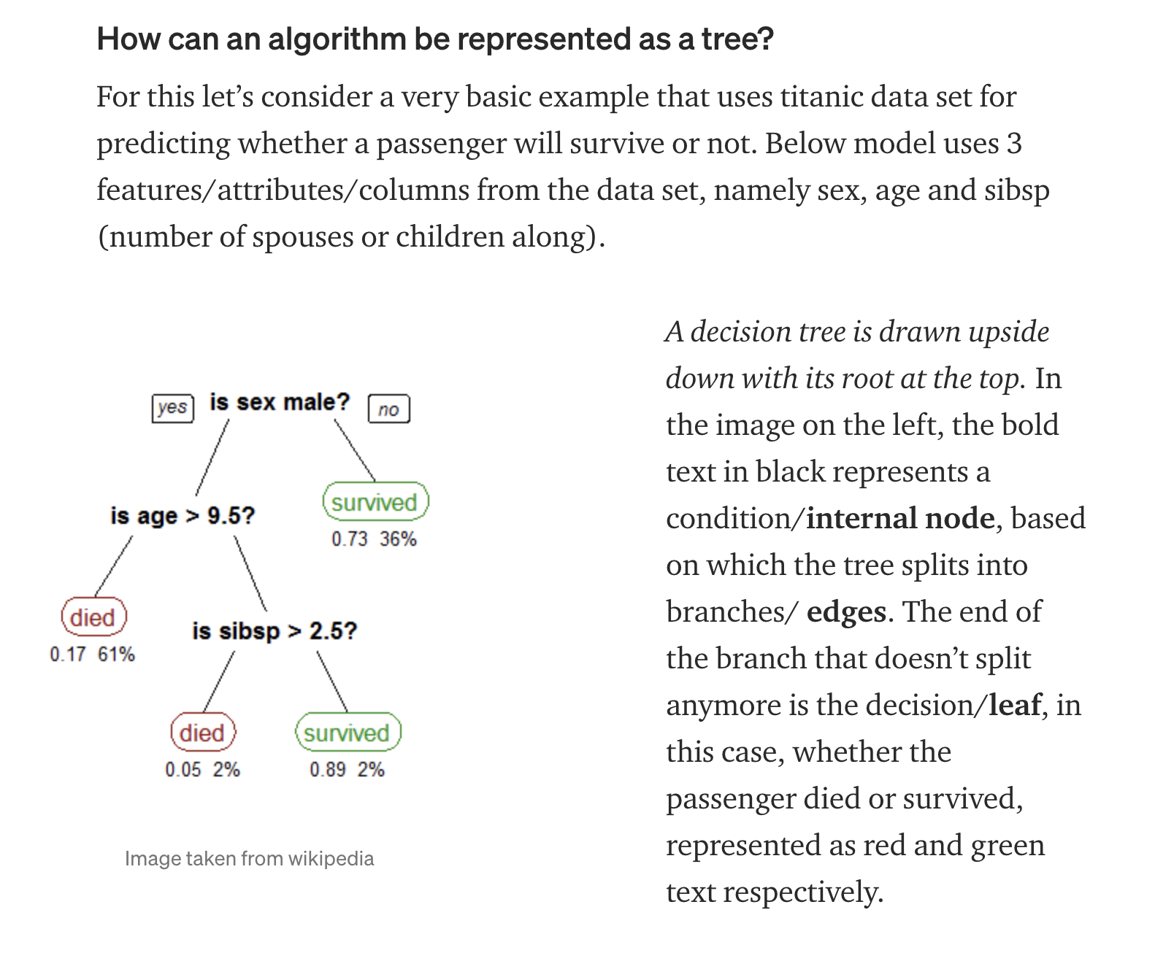
Decision Tree Example
Purdue University Global |Foundations of Purdue Global Culture
Notes:
https://towardsdatascience.com/decision-trees-in-machine-learning-641b9c4e8052

Slide 15
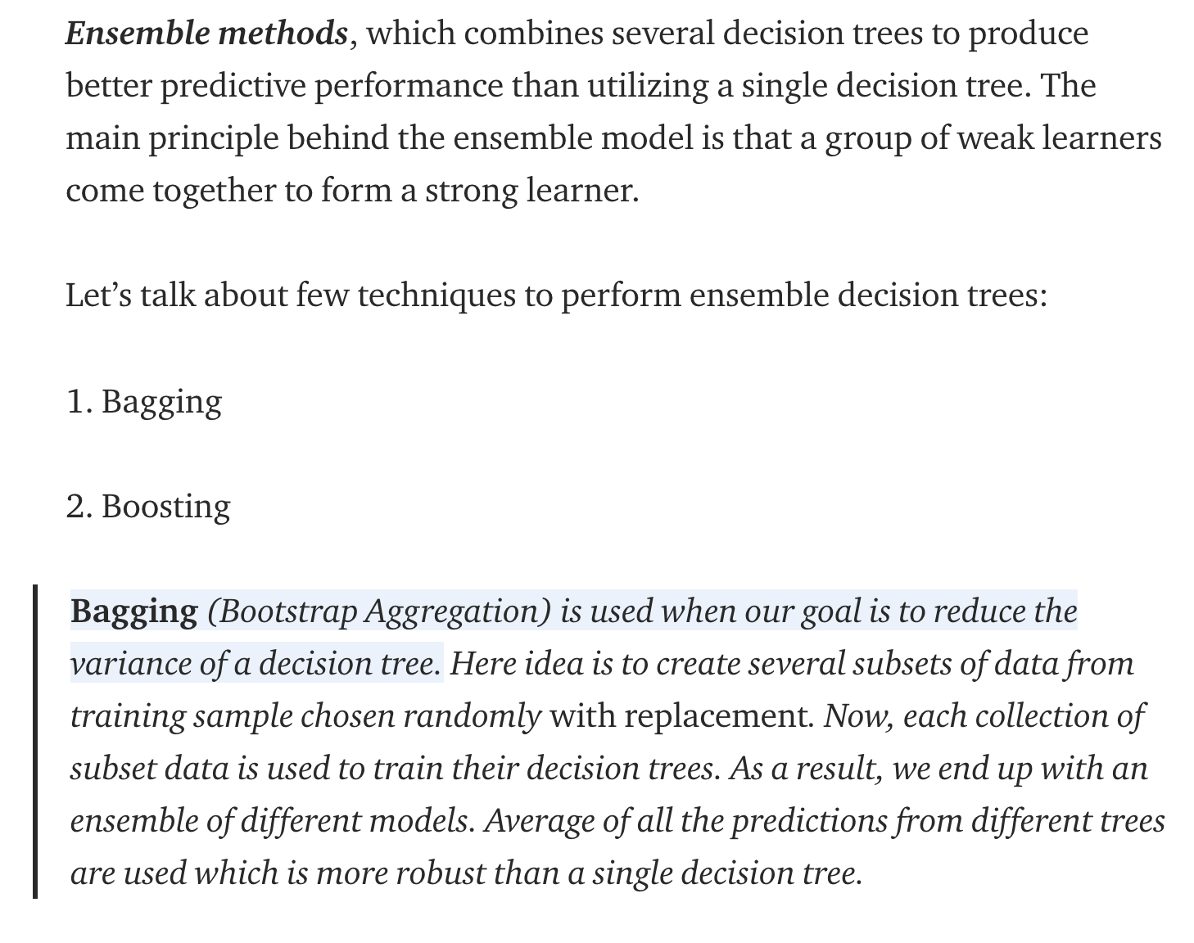
Types of Decision Trees
Purdue University Global |Foundations of Purdue Global Culture
Notes:
https://towardsdatascience.com/decision-tree-ensembles-bagging-and-boosting-266a8ba60fd9

Slide 16
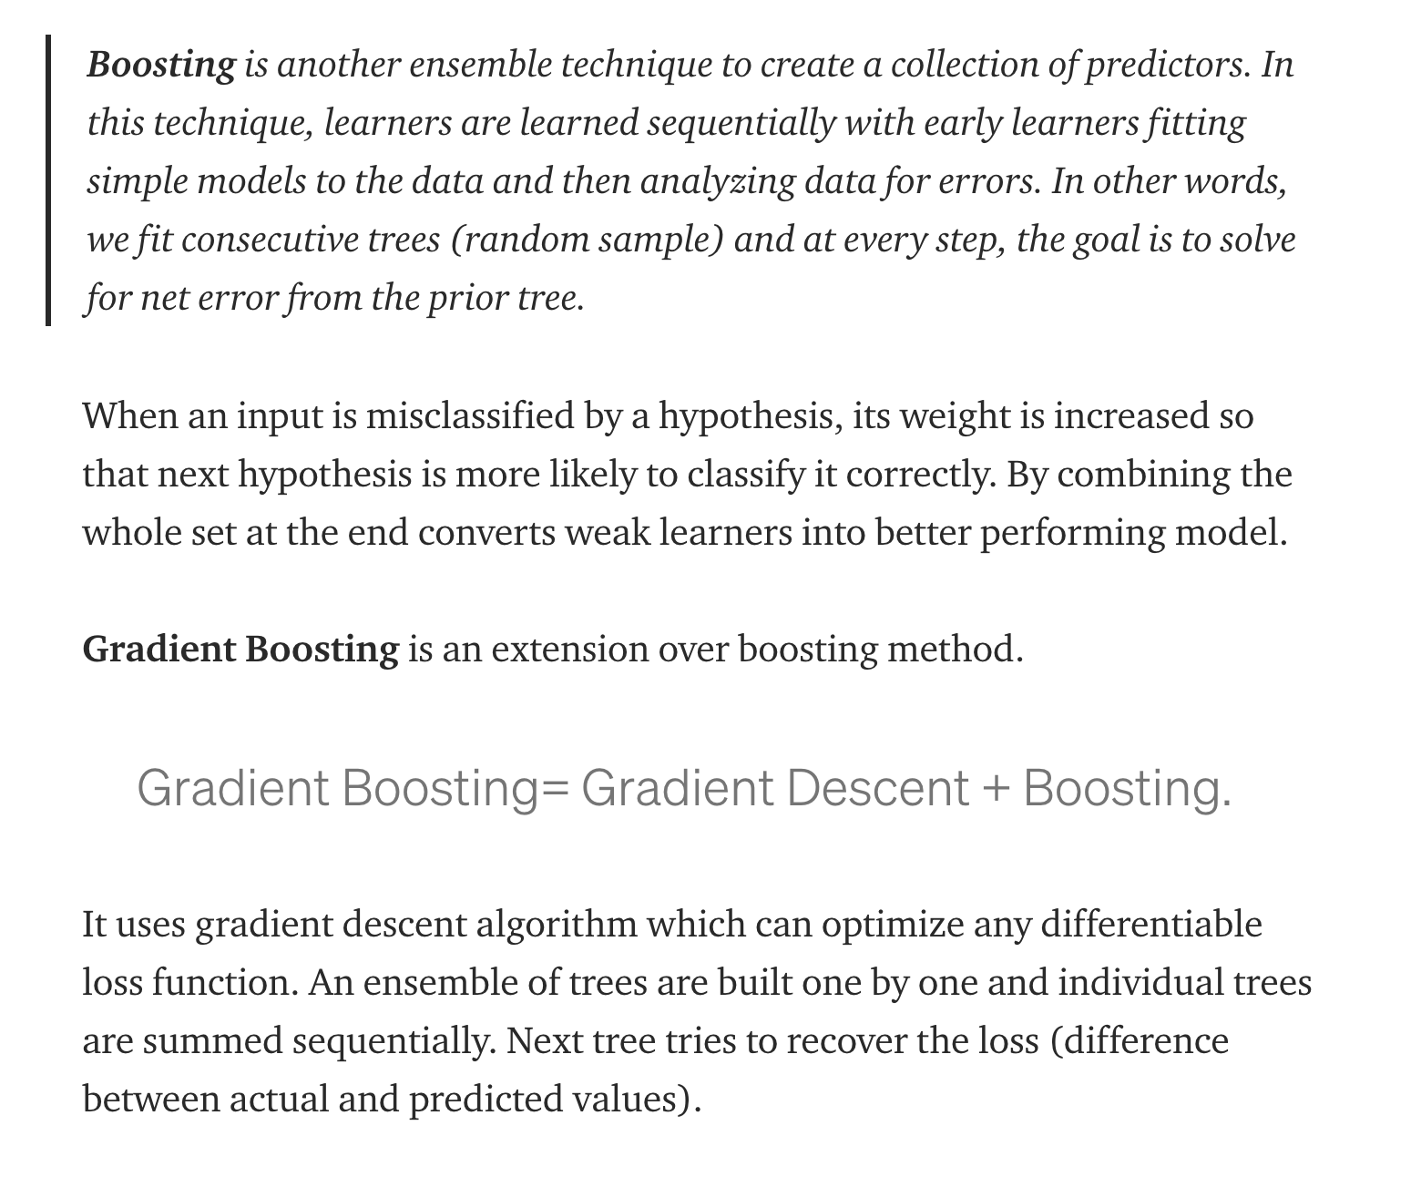
Types of Decision Trees
Purdue University Global |Foundations of Purdue Global Culture
Notes:
https://towardsdatascience.com/decision-tree-ensembles-bagging-and-boosting-266a8ba60fd9

Slide 17
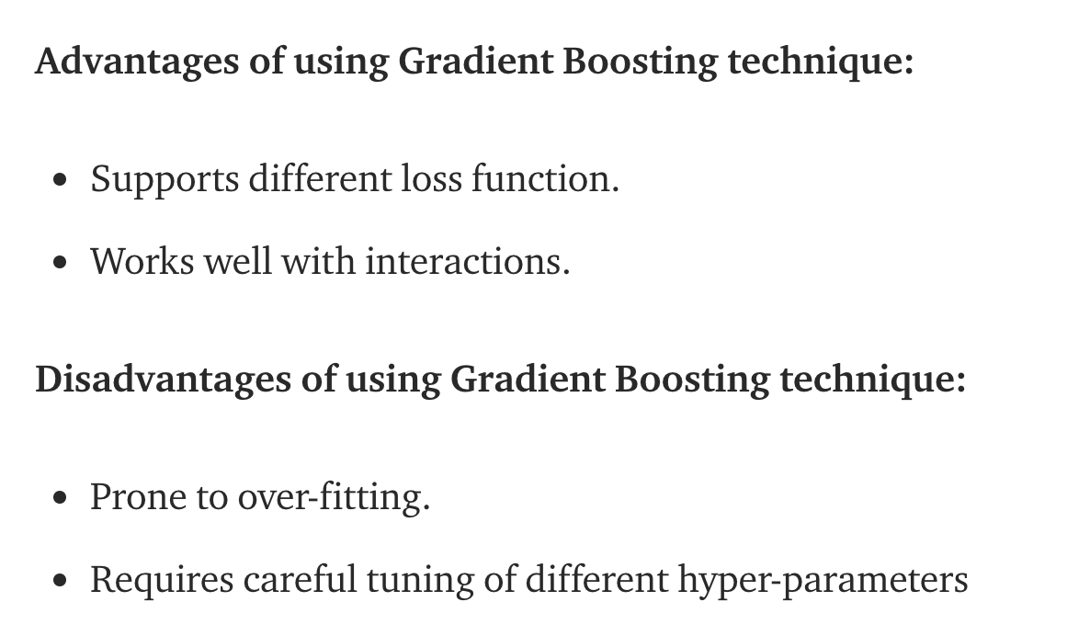
Pro/Con Gradient Boosting
Purdue University Global |Foundations of Purdue Global Culture
Notes:
https://towardsdatascience.com/decision-tree-ensembles-bagging-and-boosting-266a8ba60fd9

Slide 18
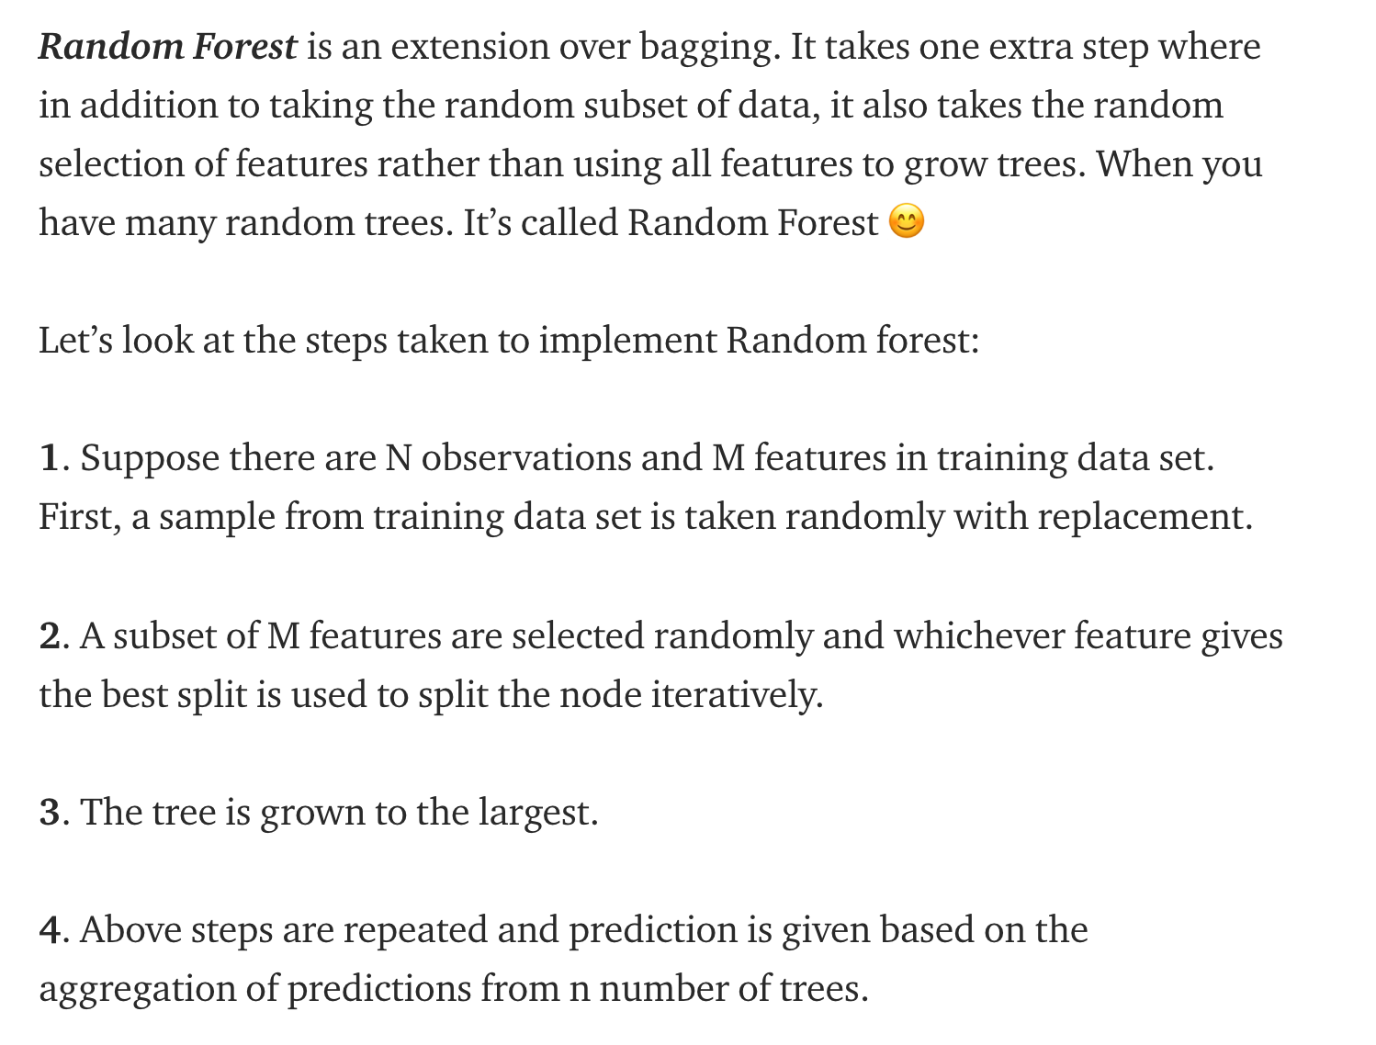
Types of Decision Trees
Purdue University Global |Foundations of Purdue Global Culture
Notes:
https://towardsdatascience.com/decision-tree-ensembles-bagging-and-boosting-266a8ba60fd9

Slide 19
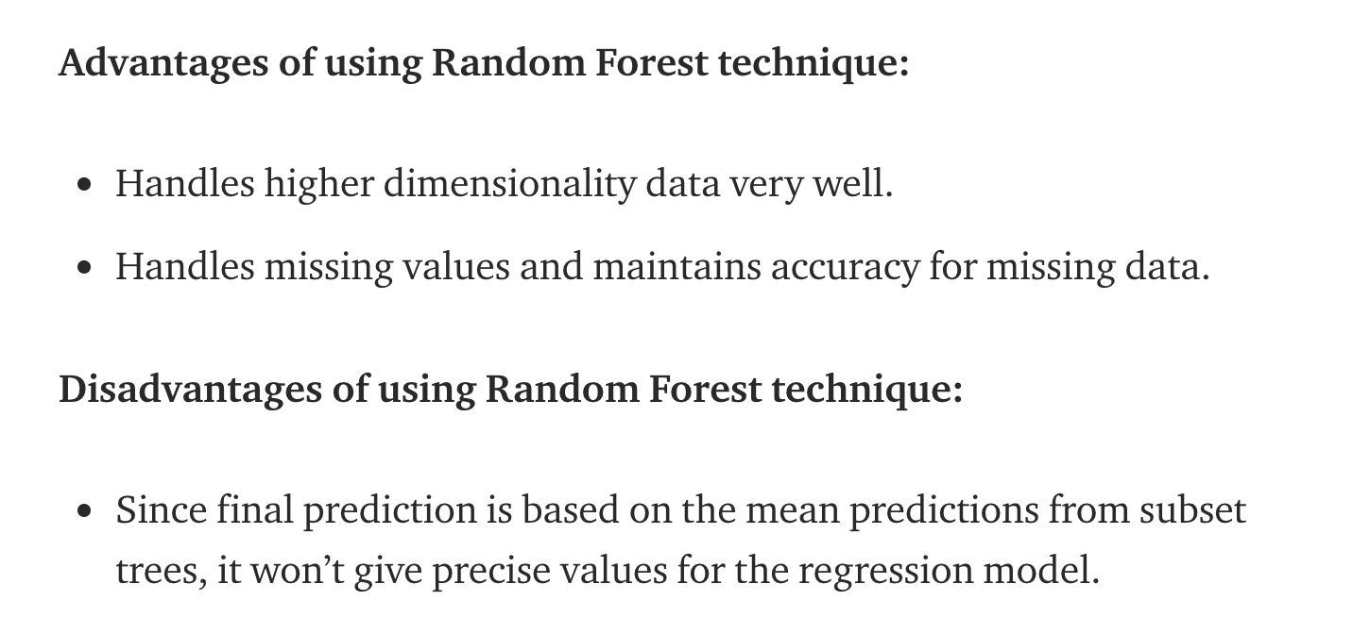
Pro/Con Random Forest
Purdue University Global |Foundations of Purdue Global Culture
Notes:
https://towardsdatascience.com/decision-tree-ensembles-bagging-and-boosting-266a8ba60fd9

Slide 20
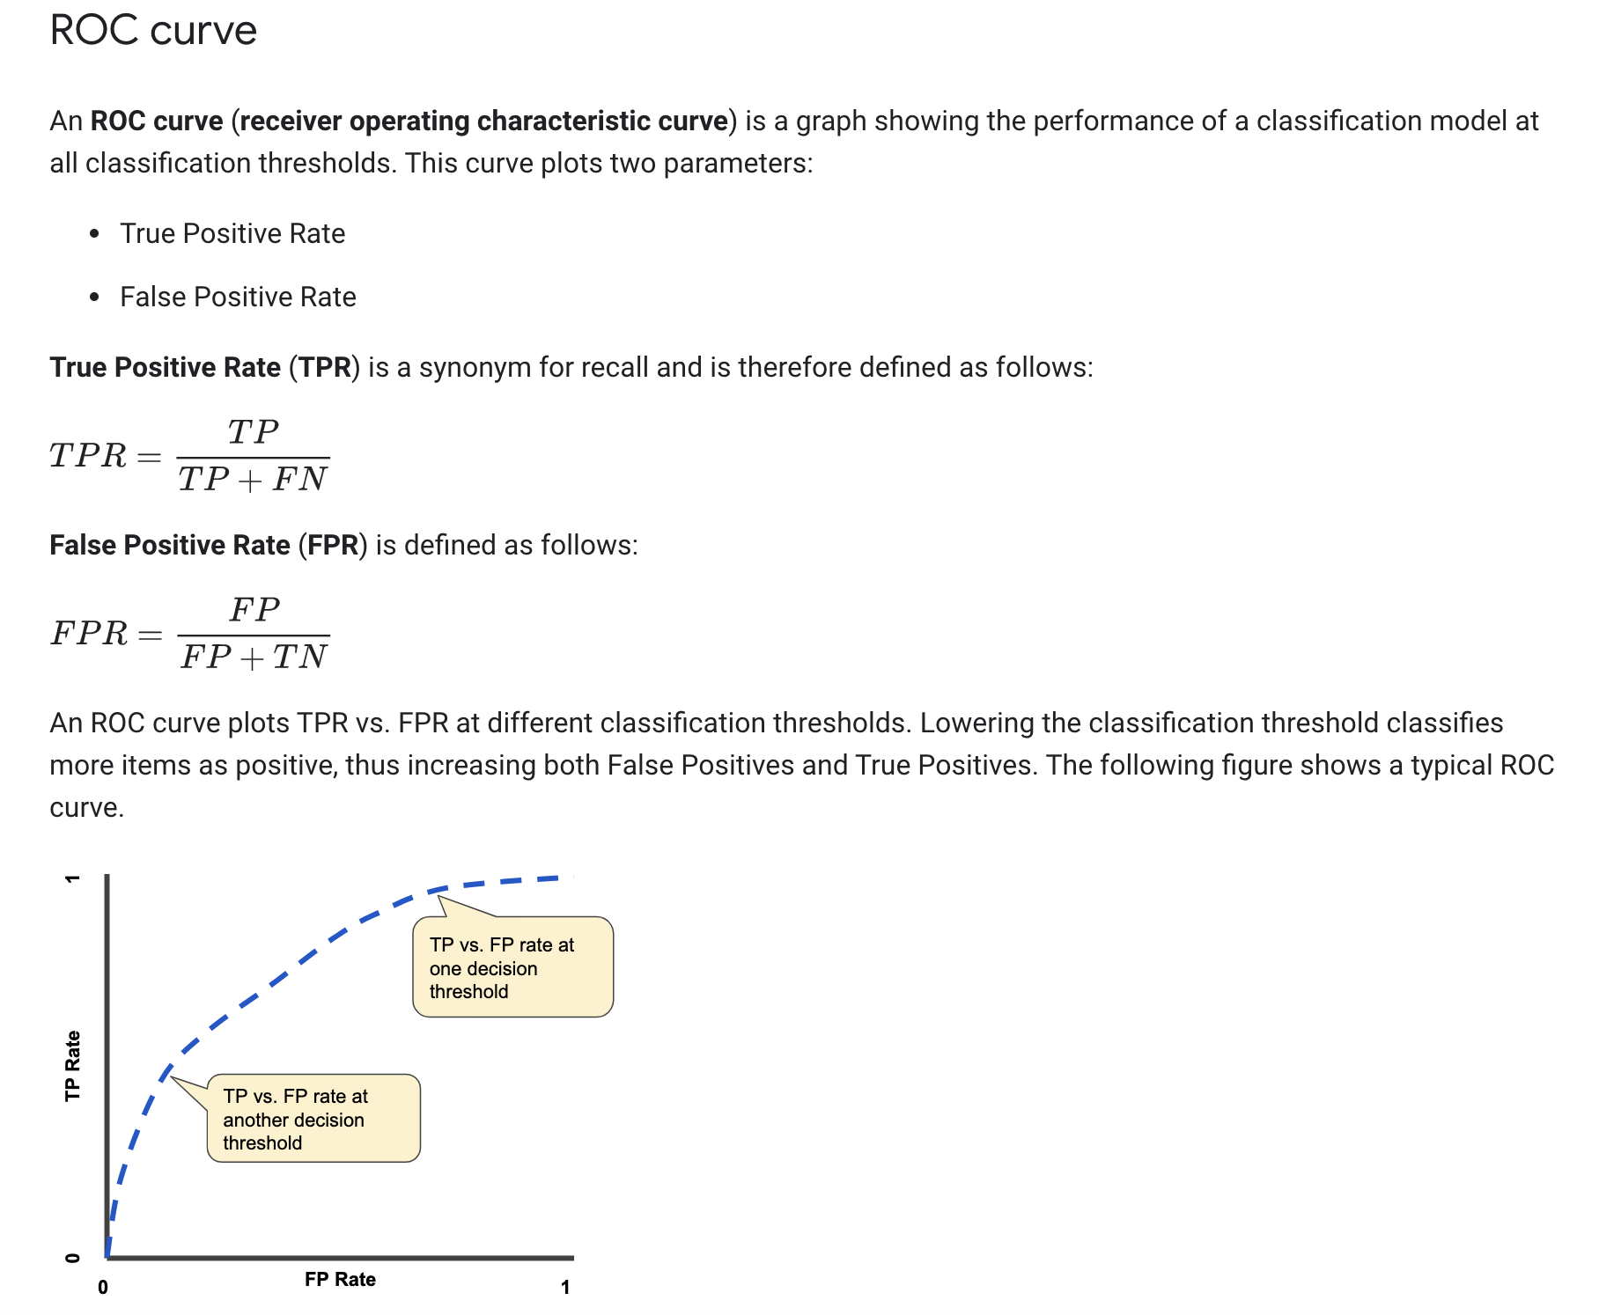
Receiver Operating Characteristic Curve
Purdue University Global |Foundations of Purdue Global Culture
Notes:
https://developers.google.com/machine-learning/crash-course/classification/roc-and-auc#:~:text=AUC%3A%20Area%20Under%20the%20ROC,to%20(1%2C1).

Slide 21
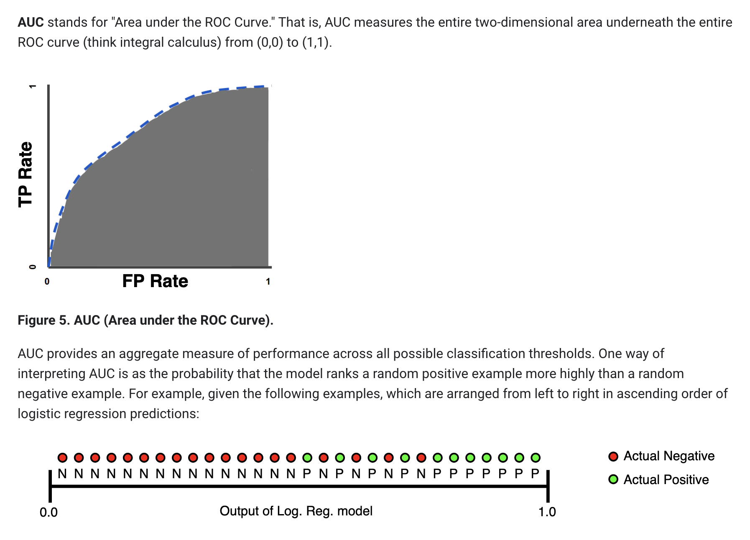
Area Under the ROC Curve
Purdue University Global |Foundations of Purdue Global Culture
Notes:
https://developers.google.com/machine-learning/crash-course/classification/roc-and-auc#:~:text=AUC%3A%20Area%20Under%20the%20ROC,to%20(1%2C1).

Slide 22
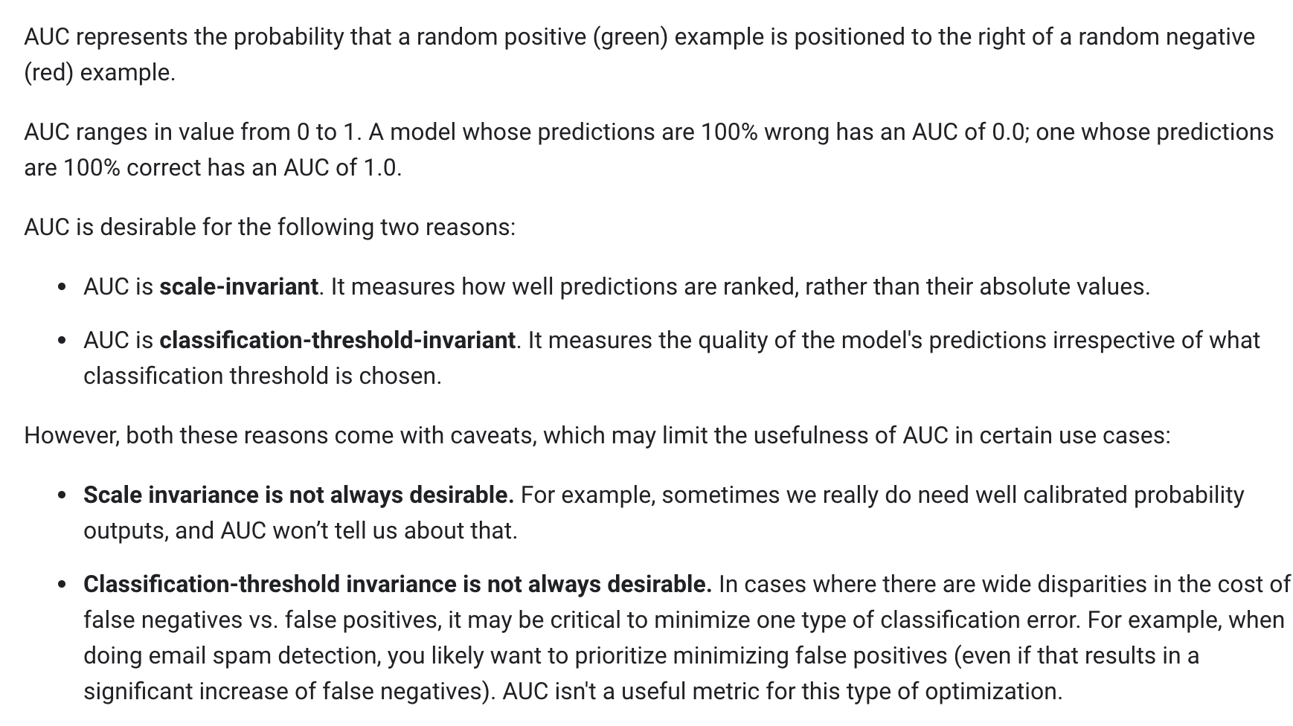
Area Under the ROC Curve
Purdue University Global |Foundations of Purdue Global Culture
Notes:
https://developers.google.com/machine-learning/crash-course/classification/roc-and-auc#:~:text=AUC%3A%20Area%20Under%20the%20ROC,to%20(1%2C1).

Slide 23
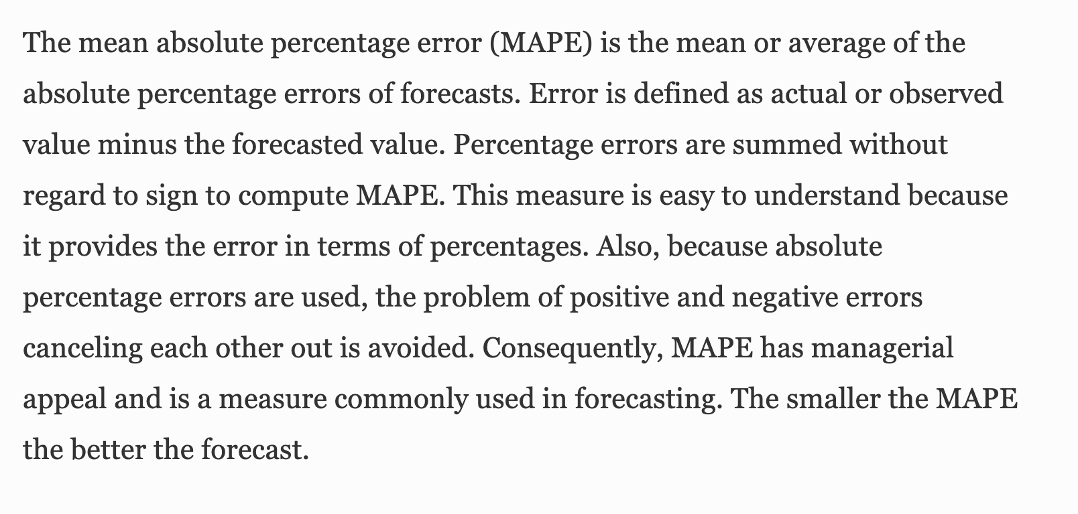
Mean Absolute Percentage Error
Purdue University Global |Foundations of Purdue Global Culture
Notes:
https://link.springer.com/referenceworkentry/10.1007%2F1-4020-0612-8_580

Slide 24
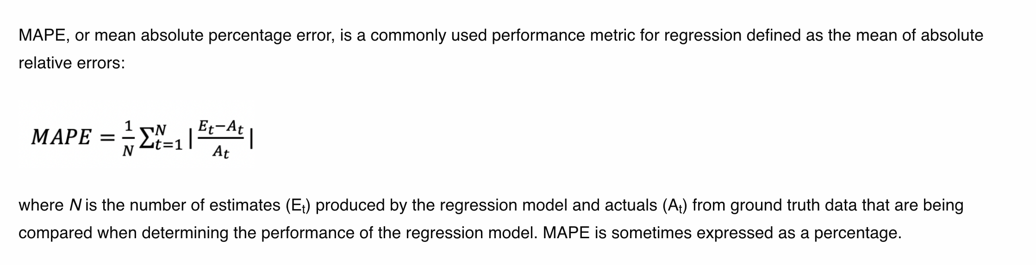
Mean Absolute Percentage Error
Purdue University Global |Foundations of Purdue Global Culture
Notes:
https://c3.ai/glossary/data-science/mean-absolute-percent-error/

Slide 25
THANK YOU
Thank you for viewing the IN498 Unit 4 presentation. Please contact your instructor at robert.kayl@purdueglobal.edu with any questions.

